Slide 1
DSI Project 1
SAT & ACT Analysis
Ng Jun Kang

Slide 2
Problem Statements
Should you take SAT? ACT? Or both?
Which state should you take SAT/ACT in?

Slide 3
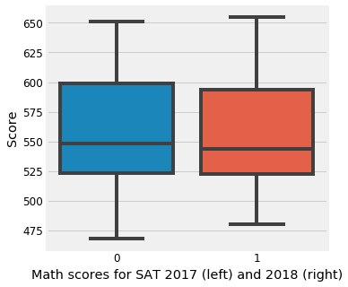
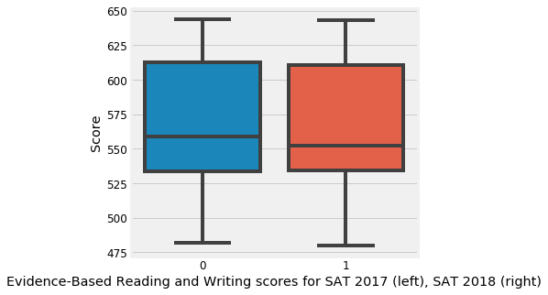
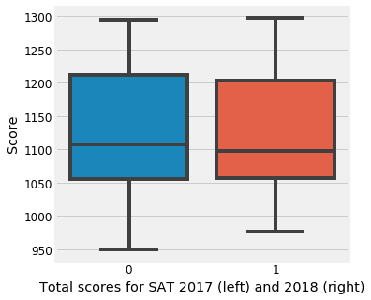
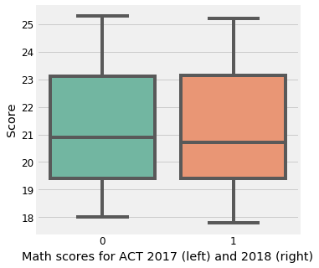
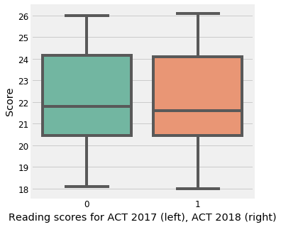
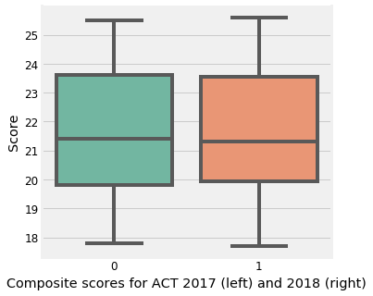
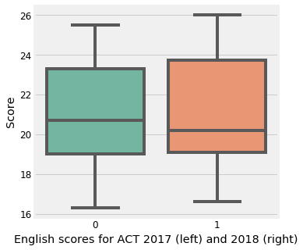
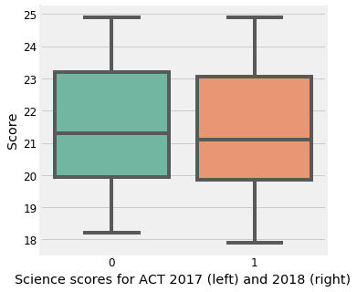

Slide 4
Should you take SAT? ACT? Or both?
A slight drop in the mean specific SAT/ACT scores from 2017 to 2018 was observed, regardless of the type of test
ACT has ended the self-paced timing for students with the extended-time accommodation. Use SAT as a backup
The difficulty levels of the tests could vary every year. An easier paper can result in lower score
Take both ACT and SAT to increase the odds of complementing your GPA score

Slide 5
Which state should you take SAT/ACT in?
Capitalize on your strength, take in states where it could demonstrate your strength
Using total/composite 2018 score as strategy:
SAT, do in District of Columbia (min 977)
ACT, do in Nevada (min 17.7)
Alternatively, strategize based on your strength:
Good in Reading, do in Hawaii or Utah or North Carolina
Good in Math, do in Nevada or District of Columbia

